Slide 1
Why Rising Inequality Has Not Led to Increased Redistribution? Candidate Number: 62622

Slide 2
Research Question: Income and wealth inequality have increased considerably during the last 40 years. Models of redistributive politics based on the MVT would have predicted an increase in taxes on high incomes and an increase in social spending. Why this did NOT happen?
Part I: Introduction to MVT and current situation of global inequality
Part II: How Political Inequality & Elite Capture affect redistribution?
Part III: Tax. How Misperception and Globalization affect tax policies, and further affect redistribution ?
Part IV: Summaries

Slide 3
Income and wealth inequality have increased considerably during the last 40 years.
Canonical Model of Median Voter Theorem: (Meltzer & Richard, 1981)
More Inequality
Poorer Median Relative To Mean
Median Prefers More Redistribution
(To Win Elections) Parties Propose Higher Taxes & Social Spending Policies

Slide 4
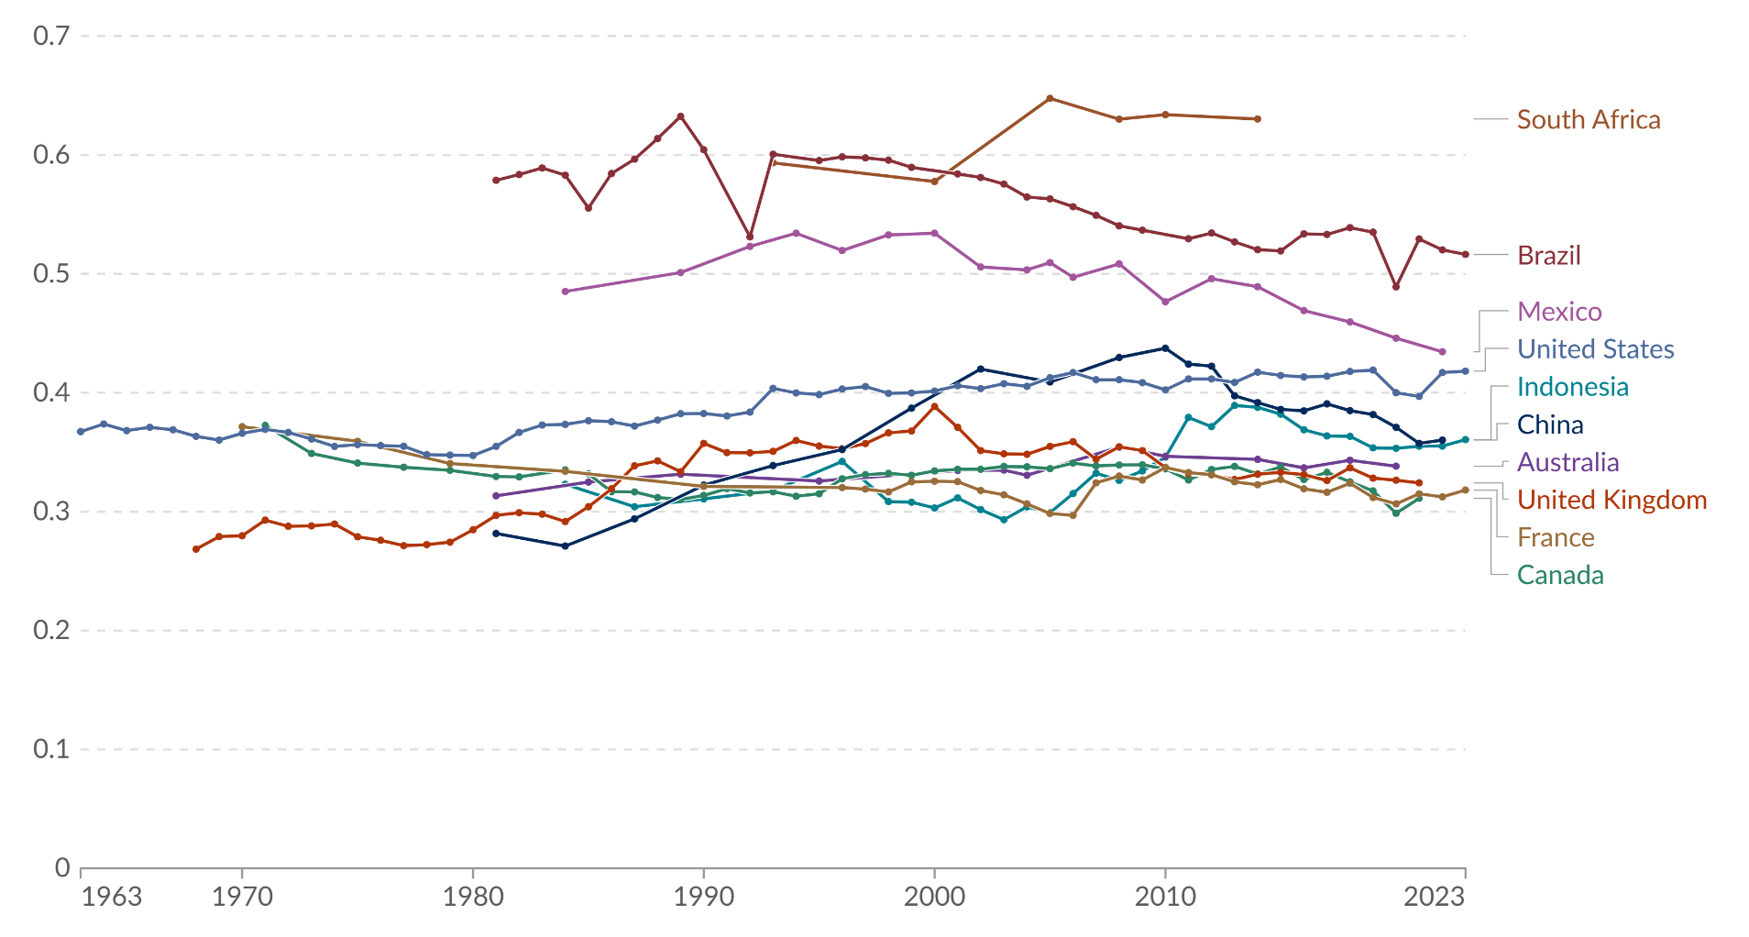
Figure 1: Income inequality (Measure In Gini Coefficient) of 10 sample countries from different geographical regions, culture background, and political regimes, 1963-2023
Data Source: World Bank Poverty and Inequality Platform (2025)

Slide 5
Why An Increase In Redistribution Did Not Happen?
1) Political Inequality & Elite Capture
Some of MVT’s Core Assumptions: A) similar probability of turning out, B) perfect information, C) pairwise voting similar influence on policy
Case study of Indonesia’s democratization led by Martinez-Bravo, Mukherjee & Stegmann (2017): after the fall of Suharto (military dictator politician), local elites entrenched under authoritarian rule were able to retain their position and continue to exert influence even after competitive elections were introduced.

Slide 6
Why An Increase In Redistribution Did Not Happen?
1) Political Inequality & Elite Capture
Some of MVT’s Core Assumptions: A) similar probability of turning out, B) perfect information, C) pairwise voting similar influence on policy
Case study of Indonesia’s democratization led by Martinez-Bravo, Mukherjee & Stegmann (2017): after the fall of Suharto (military dictator politician), local elites entrenched under authoritarian rule were able to retain their position and continue to exert influence even after competitive elections were introduced.
By investing in de facto power, which includes alliances with the military, bribery, vote buying, etc.
In such environments, even if inequality rises, the preferences of the poorer median voter are unlikely to translate into higher taxes or social spending, even with an increase in citizens’ power in elections.

Slide 7
Statistics About the Political Inequality & Elite Capture In Indonesia:
Suharto’s authoritarian regime lasts from 1965–1998, Indonesia democratized from 1999, but Suharto-appointed mayors were not immediately replaced. (allowed to finish 5-year terms from 1998-2003)
The research team found that:
In the first direct mayoral elections (2005–2008), 71% of districts elected “elite-connected mayors” (from old-regime elite background)
Each extra year of exposure to the “Old Suharto Mayors” From 1998-2003 increases the probability of elite persistence in that district by about 11%.
Districts with longer exposure to “Suharto mayors” have Fewer candidates, and Lower numbers of independent candidates.

Slide 8
Statistics About the Political Inequality & Elite Capture In Indonesia:
Suharto’s authoritarian regime lasts from 1965–1998, Indonesia democratized from 1999, but Suharto-appointed mayors were not immediately replaced. (allowed to finish 5-year terms from 1998-2003)
The research team found that:
In the first direct mayoral elections (2005–2008), 71% of districts elected “elite-connected mayors” (from old-regime elite background)
Each extra year of exposure to the “Old Suharto Mayors” From 1998-2003 increases the probability of elite persistence in that district by about 11%.
Districts with longer exposure to “Suharto mayors” have Fewer candidates, and Lower numbers of independent candidates.
These patterns indicate that the lack of increasing redistribution, in some areas, is due to persistent political inequality and elite capture.
And it is worth noting that: countries that are democratic today can still carry strong political legacies from their historical authoritarian periods. (e.g. South Korea)

Slide 9
Why An Increase In Redistribution Did Not Happen?
1) Political Inequality & Elite Capture
What about developed, democratic countries?
Research team led by Dal Bó et al. (2017) on Sweden:
- Politicians are not drawn from the median citizen: richer, better educated, from more affluent families
- Higher income & better-educated citizens participate political activities more actively (i.e. elections)
They sit closer to the top, and may see the world through elite eyes.
Policy reflect a “rich-weighted” median rather than the actual median citizen

Slide 10

Why An Increase In Redistribution Did Not Happen?
2) Tax
In the canonical model of MVT (Meltzer & Richard, 1981), the equilibrium tax rate is decided by
Inequality: desire for redistribution increases when mean income gets higher than the median (tax the rich!).
Elasticity of the tax base: Increase in tax rate reduces the tax base (labour supply), and the extent depends on the elasticity.
mean income
median income
equilibrium tax rate
elasticity
Figure 2: Canonical Model For Tax Equilibrium

Slide 11
Why An Increase In Redistribution Did Not Happen?
2) Tax: Misperceptions
Inequality
– They underestimate how rich the rich actually are, and misread the “shape” of the distribution.
– They see inequality in income flows, but may not see the much more extreme concentration of wealth and assets.
But in reality, people often misperceive both inequality and wealth concentration:

Slide 12
Why An Increase In Redistribution Did Not Happen?
2) Tax: Misperceptions
Inequality
– They underestimate how rich the rich actually are, and misread the “shape” of the distribution.
– They see inequality in income flows, but may not see the much more extreme concentration of wealth and assets.
But in reality, people often misperceive both inequality and wealth concentration:
A case study in Netherland led by Douenne et al. (2024) find that:
they underestimate the inequality of wealth, compared to income. respondents think wealth is more unequal than income by 3.4%, while the real statistic is 36%.
Regardless actual position, most people tend to feel that they are close to the median (both in wealth and income). 1% increase in actual rank only shifts perceived rank by 0.31% for income and 0.27% for wealth

Slide 13
Why An Increase In Redistribution Did Not Happen?
2) Tax: Misperceptions
Inequality
– They underestimate how rich the rich actually are, and misread the “shape” of the distribution.
– They see inequality in income flows, but may not see the much more extreme concentration of wealth and assets.
But in reality, people often misperceive both inequality and wealth concentration:
Zucman (2019), in their review article on global wealth inequality finds that:
Combine China, Europe, and the US, the top 1% wealth share rose from 28% in 1980 to around 33% today, while the bottom 75% consistently own only about 10% of total wealth.
existing estimates may understate true inequality, because a rich people’s assets is deliberately hidden. Earlier work estimates that about 8% of the world’s household financial wealth—roughly 10% of world GDP, or around 5–6 trillion USD on the eve of the 2007 crisis—is held offshore in tax havens.

Slide 14
Why An Increase In Redistribution Did Not Happen?
2) Tax: Misperceptions
Inequality
– They underestimate how rich the rich actually are, and misread the “shape” of the distribution.
– They see inequality in income flows, but may not see the much more extreme concentration of wealth and assets.
But in reality, people often misperceive both inequality and wealth concentration:
Combining perspectives from Zucman and Douenne et al., it could be found that people across many regions are underestimating inequality, especially wealth inequality.
This imperfect information may lead the policy about taxation in a wrong direction, which eventually affect the redistribution.

Slide 15
Why An Increase In Redistribution Did Not Happen?
2) Tax: Globalization & Mobility
Elasticity: Globalization makes the tax base (for mobile capital & top incomes) more elastic.
During the last 40 years, globalization and financial liberalization make the tax base for top incomes and capital more mobile across borders:
Multinational firms can shift production locations and reported profits across countries.
High-wealth individuals can move financial assets into tax havens. (Zucman, 2019)
companies have more freedom to choose many countries to operate in, so governments compete harder to attract them. (Helpman et al., 2017)

Slide 16
Why An Increase In Redistribution Did Not Happen?
2) Tax: Globalization & Mobility
Elasticity: Globalization makes the tax base (for mobile capital & top incomes) more elastic.
During the last 40 years, globalization and financial liberalization make the tax base for top incomes and capital more mobile across borders:
Multinational firms can shift production locations and reported profits across countries.
High-wealth individuals can move financial assets into tax havens. (Zucman, 2019)
companies have more freedom to choose many countries to operate in, so governments compete harder to attract them. (Helpman et al., 2017)
So even if the domestic median voter would like to tax the rich more, policy-makers perceive “strong external constraints”.
They respond by: - cutting corporate tax rates, - keeping capital taxes low, - and relying more on broad consumption taxes (indirect taxes).
- Relocate firm, - capital flight, - reduce investment.

Slide 17
Summaries
1) Political Inequality & Elite Capture
Indonesia example: MVT’s assumption on similar influence on policy could be hard to achieve in some countries due to their historical politics legacy ()
Sweden example: Rich people participate political activities more actively; politicians != “true median”, they are from a richer, better educated background.
2) Tax
People’s general misperception about inequality might lead tax policies in a biased direction
Increasing globalization pressure challenges governments in listening to voices of medians.

Slide 18
Bibliography
Dal Bó, E., et al. (2017). Who becomes a politician? Quarterly Journal of Economics, 132(4), 1877–1914.
Douenne, T., et al. (2024). Equating inequality: Public perceptions of income and wealth distributions. VoxEU.
Helpman, E., et al. (2017). Trade and inequality: From theory to estimation. Review of Economic Studies, 84(1), 357–405.
Martinez-Bravo, M., Mukherjee, P., & Stegmann, A. (2017). The non-democratic roots of elite capture: Evidence from Soeharto mayors in Indonesia. Econometrica, 85(6), 1991–2010.
Meltzer, A. H., & Richard, S. F. (1981). A rational theory of the size of government. Journal of Political Economy, 89(5), 914–927.
World Bank. (2025). Poverty and Inequality Platform (PIP) Dataset. World Bank.
Zucman, G. (2019). Global wealth inequality. Annual Review of Economics, 11, 109–138.

